Slide 1
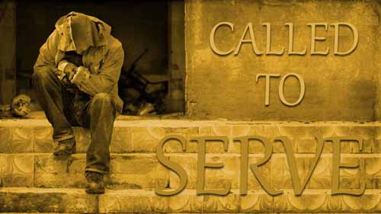
Mind-set
Luke 17:7-10

Slide 2
Mind-set
Luke 17:7-10
Mind-set – a fixed state of mind.
I. Our Identification (17:7).
Exo 21:16 And he that stealeth a man, and selleth him, or if he be found in his hand, he shall surely be put to death.
Eph 6:9 And, ye masters, do the same things unto them, forbearing threatening: knowing that your Master also is in
heaven; neither is there respect of persons with him.

Slide 3
Mind-set
Luke 17:7-10
Mind-set – a fixed state of mind.
I. Our Identification (17:7).
Our Identification – we are slaves of the Lord Jesus Christ.
In a master-slave relationship, there’s never a scenario where it is acceptable for the slave to be first.
Mat 10:24 The disciple is not above his master, nor the servant above his lord.

Slide 4
Mind-set
Luke 17:7-10
Mind-set – a fixed state of mind.
I. Our Identification (17:7).
II. Our Obligation (17:8).
Obligation - something one is bound to do.
Col 4:17 And say to Archippus, Take heed to the ministry which thou hast received in the Lord, that thou fulfil it.

Slide 5
Mind-set
Luke 17:7-10
Mind-set – a fixed state of mind.
I. Our Identification (17:7).
II. Our Obligation (17:8).
Acts 14:19 And there came thither certain Jews from Antioch and Iconium, who persuaded the people, and, having stoned Paul, drew him out of the city, supposing he had been dead. 14:20 Howbeit, as the disciples stood round about him, he rose up, and came into the city: and the next day he departed with Barnabas to Derbe. 14:21 And when they had reached the gospel to that city, and had taught many, they returned again to Lystra, and to Iconium, and Antioch, 14:22 Confirming the souls of the disciples, and exhorting them to continue in the faith, and that we must through much tribulation enter into the kingdom of God.

Slide 6
Mind-set
Luke 17:7-10
Mind-set – a fixed state of mind.
I. Our Identification (17:7).
II. Our Obligation (17:8).
III. Our Expectation (17:9).
Expectation – expecting something.
“Real humility is not thinking too high of yourself or thinking too low of yourself, it’s not thinking of yourself.”

Slide 7
Mind-set
Luke 17:7-10
Mind-set – a fixed state of mind.
I. Our Identification (17:7).
II. Our Obligation (17:8).
III. Our Expectation (17:9).
Mat 23:5 But all their works they do for to be seen of men: they make broad their phylacteries, and enlarge the borders of their garments, 23:6 And love the uppermost rooms at feasts, and the chief seats in the synagogues, 23:7 And greetings in the markets, and to be called of men, Rabbi, Rabbi.

Slide 8
Mind-set
Luke 17:7-10
Mind-set – a fixed state of mind.
I. Our Identification (17:7).
II. Our Obligation (17:8).
III. Our Expectation (17:9).
IV. Our Resignation (17:10).
Resignation – to give (oneself) over without resistance.

Slide 9
Mind-set
Luke 17:7-10
Mind-set – a fixed state of mind.
I. Our Identification (17:7).
II. Our Obligation (17:8).
III. Our Expectation (17:9).
IV. Our Resignation (17:10).
John 1:27 He it is, who coming after me is preferred before me, whose shoe's latchet I am not worthy to unloose.

Slide 10
Mind-set
Luke 17:7-10
Mind-set – a fixed state of mind.
I. Our Identification (17:7).
II. Our Obligation (17:8).
III. Our Expectation (17:9).
IV. Our Resignation (17:10).
John 15:15 Henceforth I call you not servants; for the servant knoweth not what his lord doeth: but I have called you friends; for all things that I have heard of my Father I have made known unto you.

